Slide 1
CapSTONE PROJECT overview Art Fogiel 1/12/18
MY BACKGROUND
WHAT IS…..
C#/ Wpf /XAML
Mvvm
INTERFACES
Xaml BINDINGS
sPlitting the work
Ui driven design
Using visual studio
Our visual studio solution

Slide 2
My background
WORKED 3 YEARS AS A SOFTWARE TESTER
WORKED ~4 YEARS AS A SOFTWARE DEVELOPER
COMPANY WRITES WINDOWS DESKTOP APPS IN C#/WPF FOR CONTROLLING CHEMISTRY LAB INSTRUMENTS AND VIEWING DATA
I KNEW I COULD GET AN APP UP AND RUNNING QUICKLY AND ENSURE EACH OF US HAD A ROLE AND A SANDBOXED AREA TO WORK IN
USING INTERFACES I COULD MAKE A TEMPLATE (FILL IN THE CODE TO DO THIS) TO MAKE IT EASIER ON EVERYONE

Slide 3
C#
C# is a High level Microsoft language supporting Object Oriented Programming
WPF
WPF (Windows Presentation Foundation) is a Microsoft technology for making Graphical User Interface applications. It is used in Desktop applications and Microsoft’s newer Universal Windows Platform (although called UWP instead of WPF its really the same)
WPF uses a mixture of C# and XAML
Created to more easily separate UI code from Business Logic. Also allows easier division for editing so a graphic designer could generate without any behind code.
Allows skinnable apps to be more easily created.
XAML
(Extensible Application Markup Language) which is XML based.
Allows editing without code behind and placing UI behavior right in the xml.

Slide 4
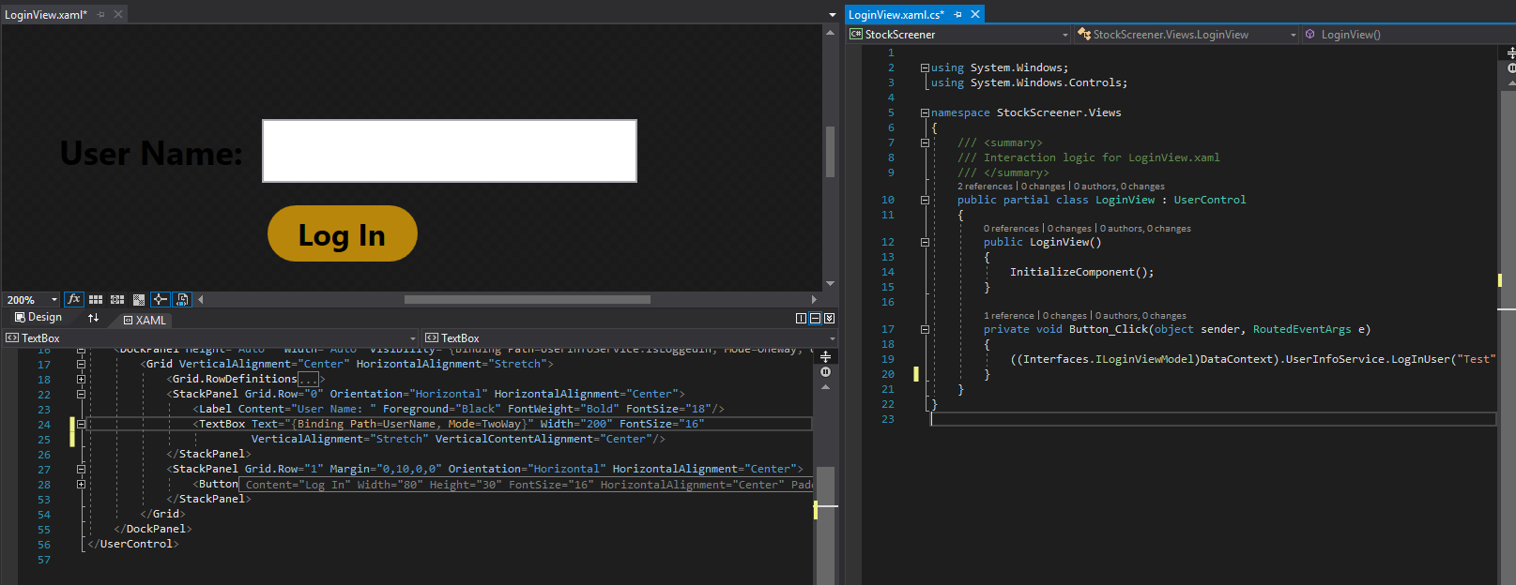
C#/WPF/XAML EXAMPLE
XAML with Designer on top
C# code behind

Slide 5
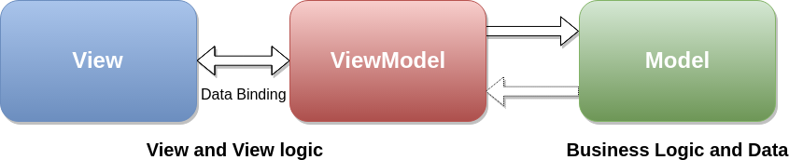
mvvm
MVVM is a design pattern called MODEL VIEW VIEW-MODEL. THERE ARE OTHER SIMILAR DESIGN PATTERNS: MVC, MVP ETC.
GOAL IS TO CREATE SEPERATED LAYERS FOR AN APPLICATION SO THE UI IS SEPERATED FROM THE BUSINESS LOGIC
WPF PLAYS PERFECT WITH THIS DESIGN THROUGH ITS ABILITY TO BIND TO PROPERTIES
THE CONCEPT IS THE VIEW (UI) REFLECTS PROPERTIES OR CALLS METHODS ON THE VIEW MODEL (IN WPF THROUGH BINDINGS). THE USER IS INTERACTING WITH THE VIEW BUT ALL CODE COMMANDS/CHANGES ARE HAPPENING IN THE VIEW MODEL.
THE VIEW MODEL’S JOB IS PROVIDE PROPERTIES OR METHODS TO SUPPORT VIEWS. IT DOES NOT ACTUALLY KNOW ANYTHING ABOUT THE VIEW THOUGH
THE MODEL (OR SERVICE) IS STRICTLY BUSINESS CODE THAT DOES NOT CARE ABOUT UI’S OR SUPPORTING THEM. THEY CAN LIVE COMPLETELY ON THEIR OWN AND KNOW NOTHING ABOUT THE VIEW MODEL OR VIEW

Slide 6
MVVM IN ACTION
Example of an Application to run an Instrument Connection UI
STUDENT
TEACHER
SCIENTIST
TECHNICIAN
VIEWS
VIEW MODEL
MODEL
SERVICE KNOWS NOTHING ABOUT THE REST.
VIEW MODEL MESSAGES THE SERVICE TO SUPPORT THE VIEWS.
ANYKIND OF VIEW THAT KNOWS ABOUT A CONNECTVIEWMODEL CAN TALK TO
THE CONNECTVIEWMODEL

Slide 7
INTERFACES
USING AN INTERFACE ABSTRACTS FROM THE ACTUAL CODE IMPLEMENTATION
ALLOWS YOU TO WRITE CODE TO A “TEMPLATE”
CONTRACT BETWEEN VIEW AND VIEW MODEL
LETS SERVICES TELL ANYONE THAT WANTS TO USE IT WHAT IS AVAILABLE
IF YOU DON’T LIKE THE IMPLEMENTATION, MAKE A NEW CLASS THAT WRITES TO THAT INTERFACE AND OTHER CLASSES/VIEWS/SERVICES WONT BE AFFECTED.

Slide 8
Xaml bindings
UI CODE (XAML) CAN BIND THINGS DIRECTLY TO PROPERTIES (LIKE STRING TEXT FOR LABELS, OR METHODS FOR BUTTON PUSHES)
XAML BINDINGS CAN BE OF AN INTERFACE. DOES NOT NEED TO ACTUALLY KNOW WHAT CLASS WILL ACT ON IT, JUST THAT THE PROPERTY OR METHOD IS AVAILABLE
THIS ALLOWS ONE OR MULTIPLE VIEWS TO BE WRITTEN TOWARDS A VIEW MODEL INTERFACE, AND THE ACTUAL VIEW MODEL CLASS OR IMPLEMENTAION CAN VARY.

Slide 9
splitting the work
WE CAN EASILY SPLIT THE WORK INTO 3 GROUPINGS. AS LONG AS WE USE INTERFACES WE CAN WORK IN OUR LITTLE SANDBOXED AREAS AND NOT REALLY AFFECT EACH OTHER EARLY ON.
VIEWS
VIEW MODELS
MODELS
IMPLEMENTATION OF WHAT
HAPPENS WHEN A BUTTON IS PRESSED
TALKS TO MODEL TO GET STOCK INFO
PROVIDES STRING OR CLASSES FOR UI TO SHOW
IMPLEMENTATION OF TALKING TO SOME OUTSIDE SOURCE TO GATHER STOCK INFO.
PROVIDE METHODS FOR OTHERS TO CALL TO GIVE STOCK INFO
UI
BUTTONS
TEXT
DISPLAY TABLE

Slide 10
UI Driven design
NORMALLY YOU WOULD DESIGN AROUND REQUIREMENTS/FEATURES
IN OUR CASE WE CAN USE THE MOCKUP TO CREATE A UI DRIVEN DESIGN
BASICALLY: I WILL MAKE THE UI TO THE MOCK UP AND PROVIDE WHOEVER DOES THE VIEW MODEL WITH AN INTERFACE OF WHAT I NEED TO SUPPORT ALL THE UI FEATURES
THE VIEW MODEL PERSON NEEDS TO IMPLEMENT THE INTERFACE AND CAN COME UP WITH THE INTERFACE FOR THE PERSON IMPLEMENTING THE MODEL SINCE IT NEEDS TO ASK THAT PERSON FOR INFORMATION
THE MODEL PERSON THEN IMPLEMENTS THE INTERFACE SO WHEN THE VIEW MODEL ASKS FOR A STOCK OR STOCKS, IT WILL GO AND GET THEM

Slide 11
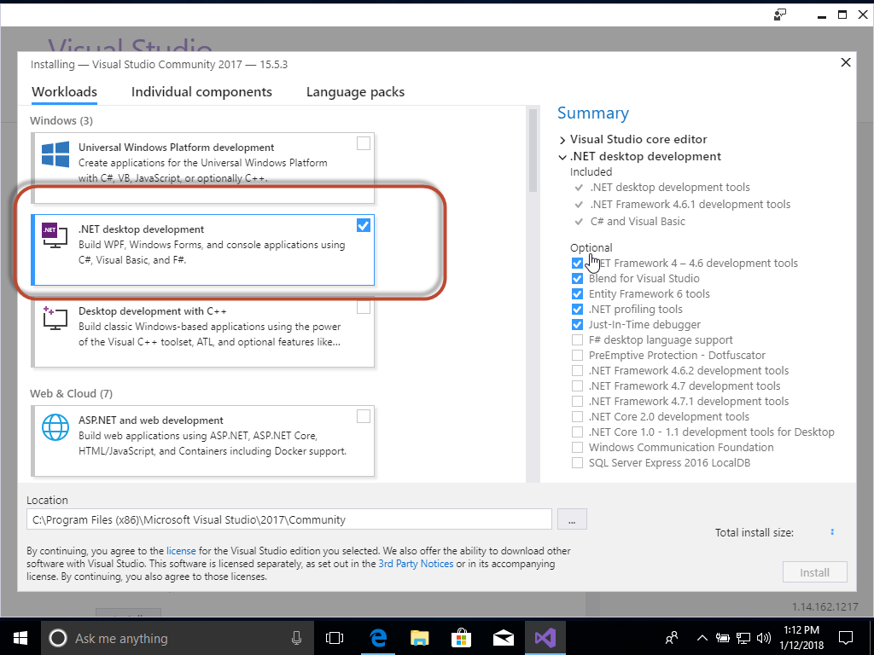
USING VISUAL STUDIO
DOWNLOAD VISUAL STUDIO 2017 (2015 IS OK IF YOU ALREADY HAVE IT) COMMUNITY EDITION IS FINE
INSTALL AND MAKE SURE AT LEAST .NET DESKTOP DEVELOPMENT IS CHECKED
WHEN DONE OPEN THE STOCKSCREENER.SLN FILE FROM VISUAL STUDIO FROM OUR GITHUB

Slide 12
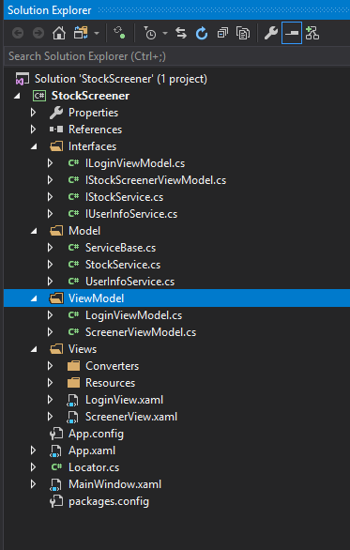
OUR SOLUTION
VIEW MODEL AND MODEL FOLDERS
CLASSES IN THOSE FOLDERS INHERIT THE CORRESPONDING INTERFACE AND NEED TO BE IMPLEMENTED
VIEW PERSON SHOULD UPDATE THE ILoginViewModel AND IStockScreenerViewModel INTERFACE
VIEW MODEL PERSON IMPLEMENTS THE LoginViewModel AND StockScreenerViewModel. ALSO UPDATES THE IStockService AND IUserInfoService INTERFACES
MODEL PERSON IMPLEMENTS THE StockService AND UserInfoService
STOCKSERVICE’S JOB IS TO GET THE STOCK QUOTES AND MANAGE THEM
USERINFOSERVICE’S JOB IS TO GET/UPDATE SETTINGS AND USER ACCOUNTS

Slide 13
IMPLEMENTATION IDEAS
Classes:
User – UserName, Settings, Watchlist
Settings – Screener selections (ranges for price etc.)
Stock – Stock symbol, latest price, % change from previous close, market cap, volume for today
Files:
UserSettings.xml: Xml serialization of a user class
StockMasterList.txt: List of all stock symbols we will ever see (Used by stock service to query through some api each stock we know of to get the info)
Open Questions:
Which API do we use to get stock quotes? Alphavantage looks promising.
Do we query all our stocks at start up (not sure how long that will take). Or do we keep a file with last known values and in the background always update that file (at least user sees something while its updating)
How are we splitting up the work?

Slide 14
Presentation
Continue Video presentation with Visual Studio walk through

Slide 15
NOTES
FEEL FREE TO CONTACT ME FOR ANY QUESTIONS EVEN DUMB ONES
I’LL HELP OUT WITH ANY PROGRAMMING ISSUES OR IDEAS
I WILL TRY TO STEP BACK SOME TO LET YOU GUYS PLAY WITH THE PROGRAMMING ASPECT, SO PLEASE SPEAK UP IF YOU NEED ANYTHING
I CAN ALSO TAKE ON MORE WORK IF WE FALL BEHIND IN ANY AREAS. I STILL NEED TO TWEAK THE SCREENER PAGE BUT I CAN MOVE FAIRLY QUICK AS I KNOW THIS PRETTY WELL. SO FAR I ONLY SPENT ABOUT 6 HOURS ON IT.

